Slide 1

A proper way of regularizing DARTS
Department of Computer Engineering
Dongseo University
Jie Yong Shin,
2023.01.26
Notes:
1

Slide 2
CONTENTS
Highlights (1)
Problem of DARTS (6)
Beta-Decay DARTS (6)
Benefits of Beta-Decay DARTS (6)
Experimental Results (5)
Conclusion (1)
Notes:
2

Slide 3
1. Highlights
Find out the reason why TD-DARTS couldn’t improve much compared to DARTS on accuracy
Prevent skip connection with Regularization
Learn an effective way to regularize Differentiable Architecture Search
Based on Beta-Decay DARTS
Observe the difference between Beta-Decay DARTS and other regularization methods
Notes:
3

Slide 4
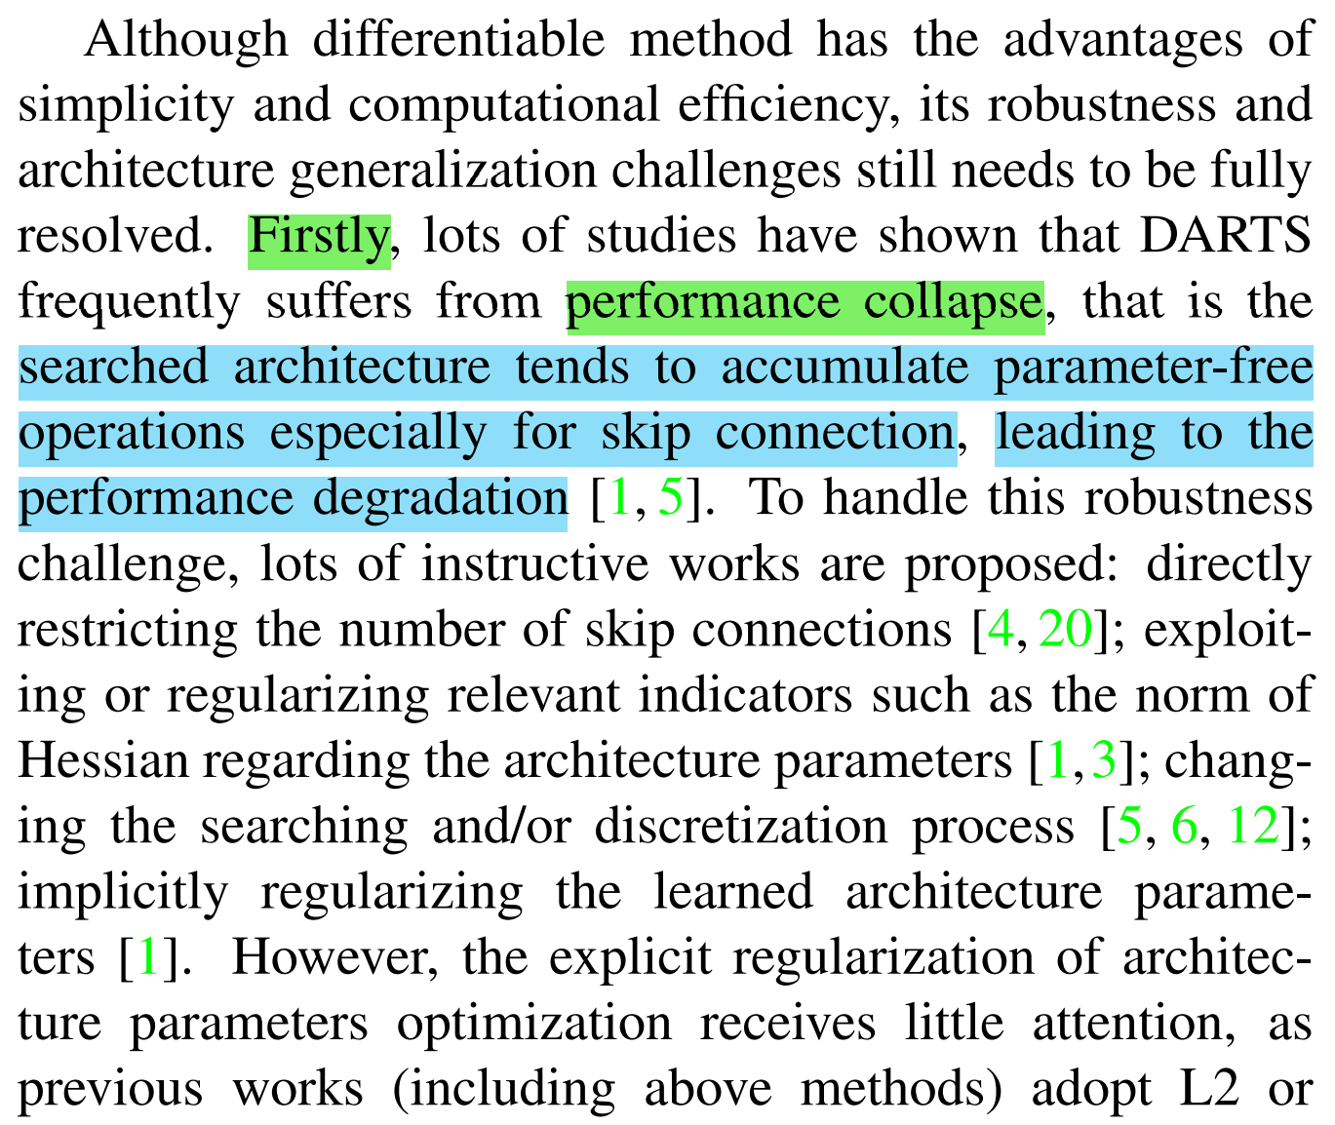
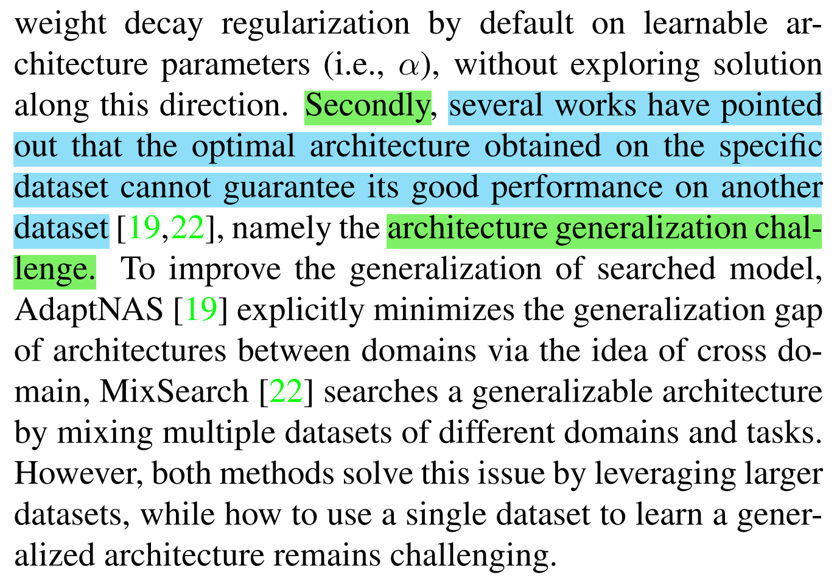
2. Problems of DARTS
Problems
Discrepancy: Between Continuously encoded architecture and Discrete architecture.
Performance Collapse: Searched architecture tends to select skip connection.
Architecture Generalization Challenge: Architecture searched in the specific dataset cannot guarantee it is good also on another dataset.
Notes:
4

Slide 5
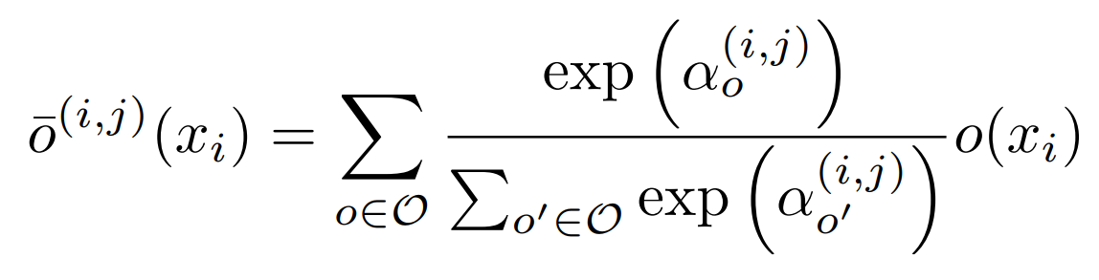
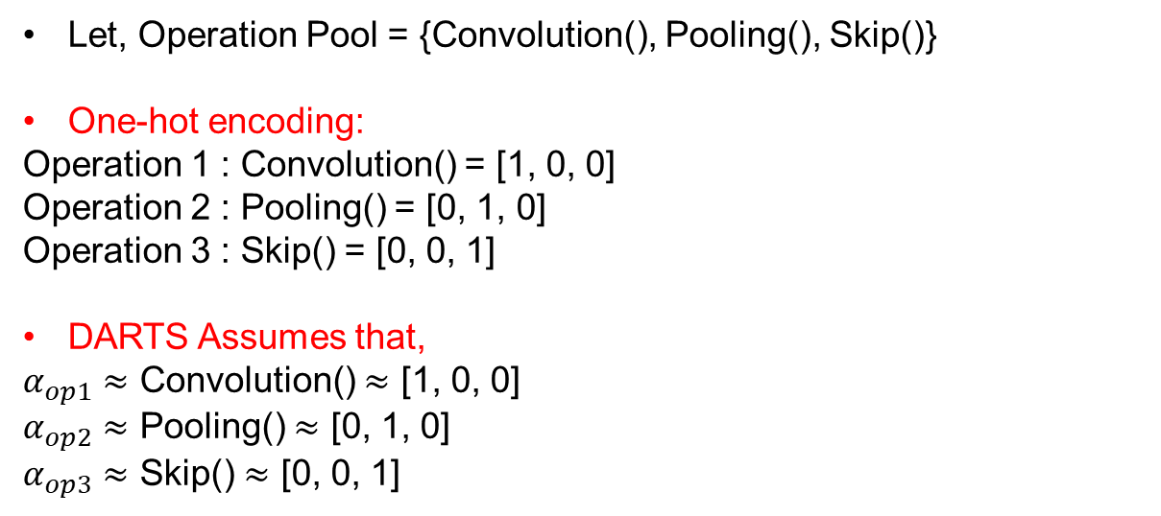
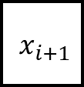
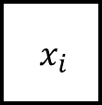
2. Problem of DARTS
$${ x}_{i}$$
$${ x}_{i+1}$$
Let, Operation Pool = {Convolution(), Pooling(), Skip()}
One-hot encoding:
Operation 1 : Convolution() = [1, 0, 0]
Operation 2 : Pooling() = [0, 1, 0]
Operation 3 : Skip() = [0, 0, 1]
DARTS Assumes that,
$α_{op1}$ $≈$ Convolution() $≈$ [1, 0, 0]
$α_{op2}$ $≈$ Pooling() $≈$ [0, 1, 0]
$α_{op3}$ $≈$ Skip() $≈$ [0, 0, 1]
Notes:
5

Slide 6
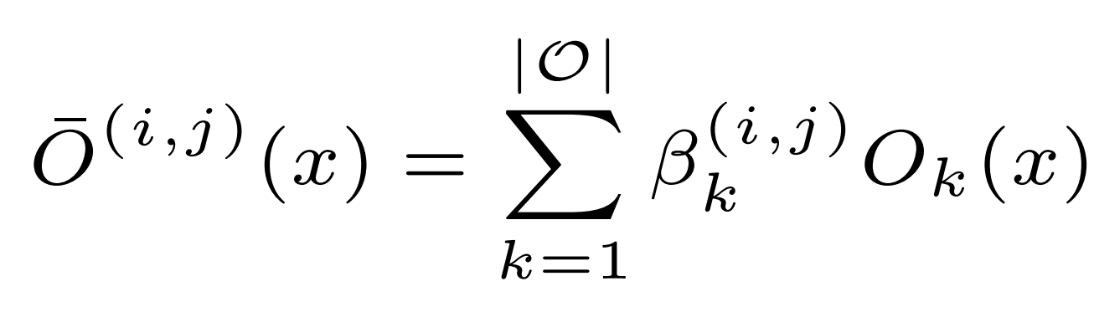
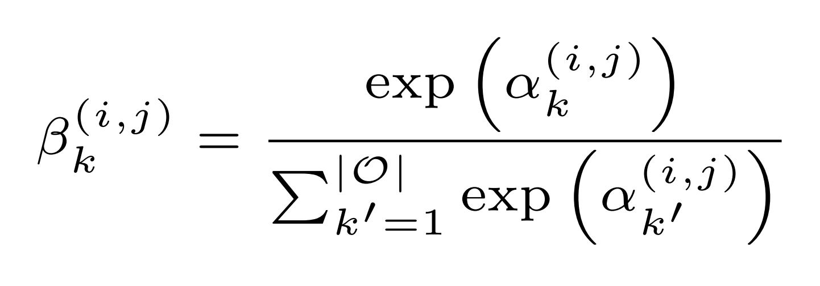
2. Problem of DARTS
Notes:
6

Slide 7

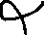


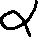
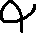


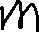

2. Problem of DARTS
Notes:
7

Slide 8







2. Problem of DARTS
Notes:
8

Slide 9





2. Problem of DARTS
Notes:
9

Slide 10
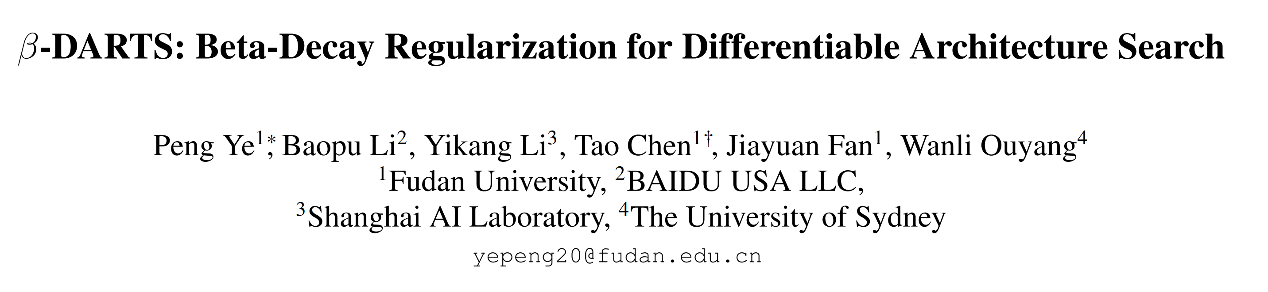
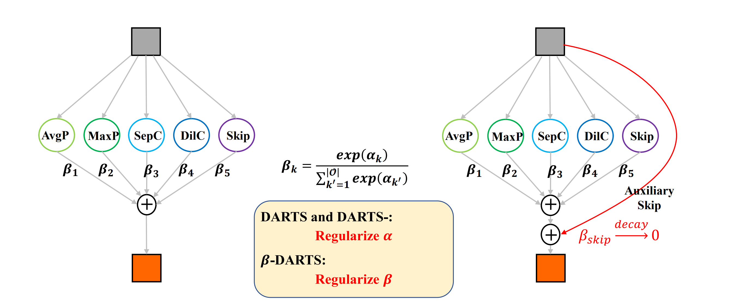
3. Beta-Decay DARTS
Notes:
10

Slide 11
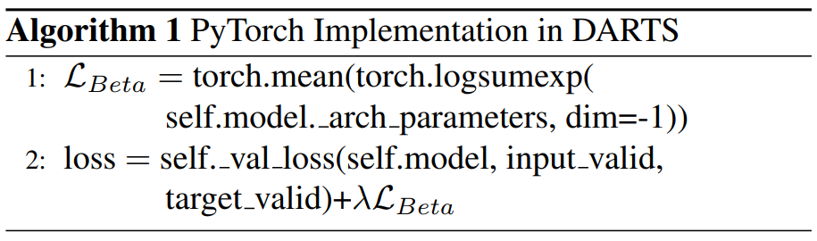
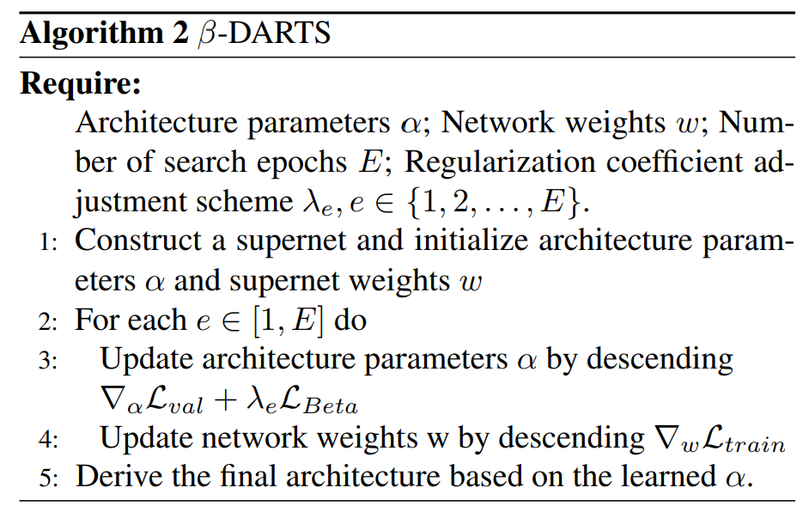
3. Beta-Decay DARTS
Notes:
11

Slide 12
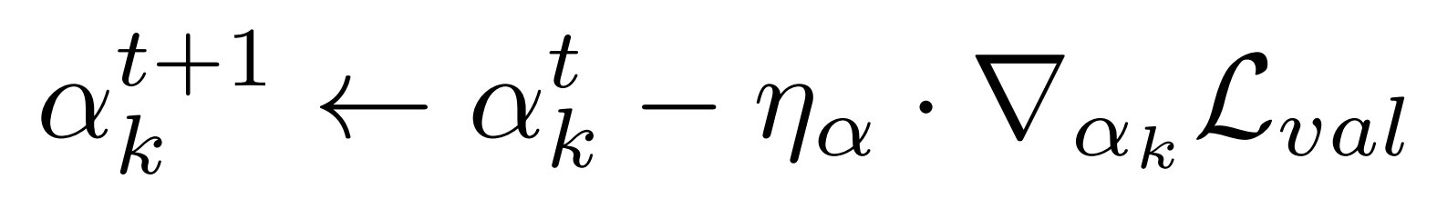
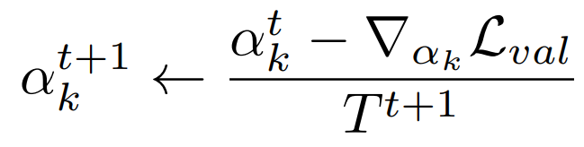
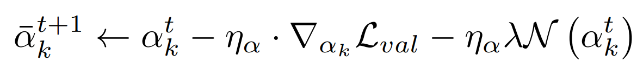
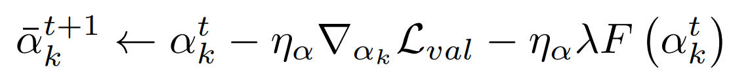
3. Beta-Decay DARTS
How DARTS update
Temperature Decay DARTS update
Commonly used regularization method on DARTS
What Beta-Decay DARTS suggests
Notes:
12

Slide 13
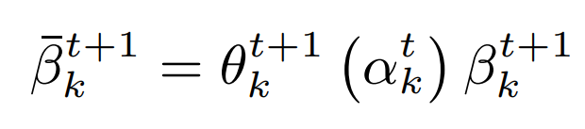
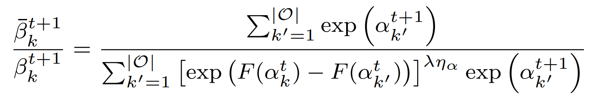
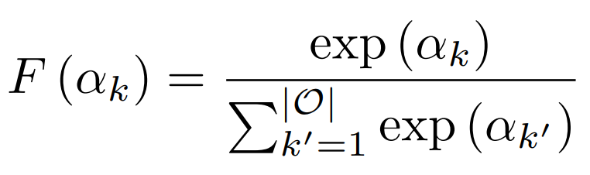
3. Beta-Decay DARTS
Constrain the value of Beta from changing too much
Note that,
Influence of Beta-Decay DARTS
Where,
Notes:
13

Slide 14
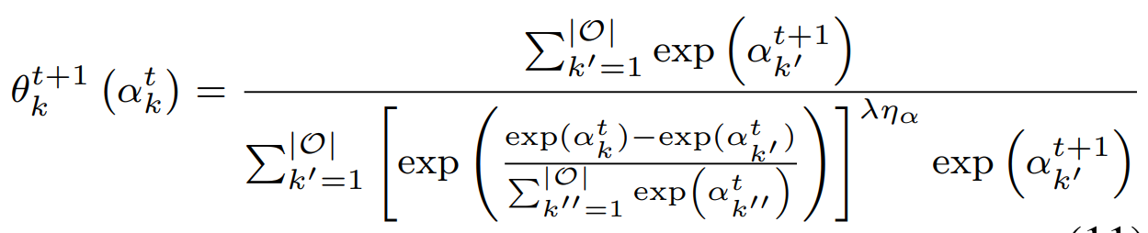
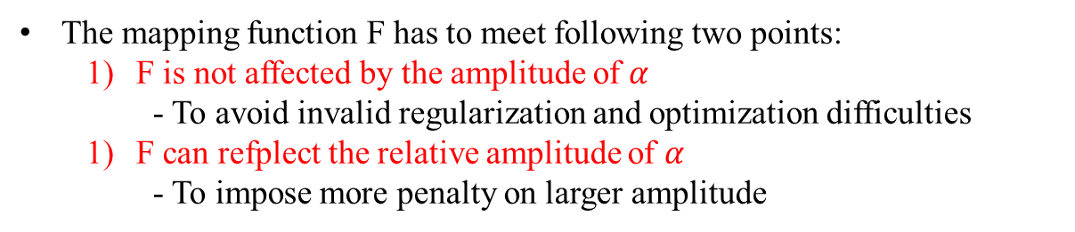
3. Beta-Decay DARTS
The mapping function F has to meet following two points:
F is not affected by the amplitude of $α$
- To avoid invalid regularization and optimization difficulties
F can refplect the relative amplitude of $α$
- To impose more penalty on larger amplitude
So, they have chosen F as
Therefore,
Notes:
14

Slide 15
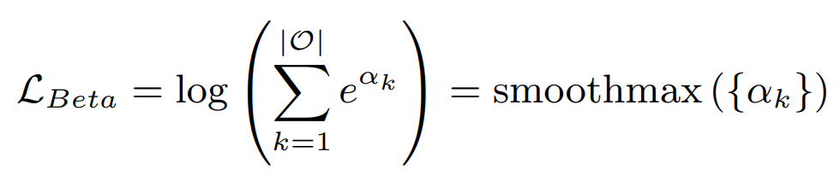
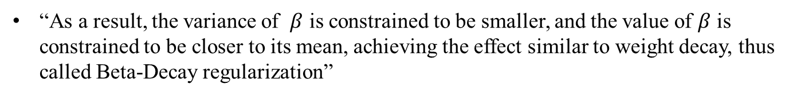
3. Beta-Decay DARTS
And to make the loss function’s gradient respective to $α$ equals F($α$),
“As a result, the variance of $β$ is constrained to be smaller, and the value of $β$ is constrained to be closer to its mean, achieving the effect similar to weight decay, thus called Beta-Decay regularization”
Notes:
15

Slide 16
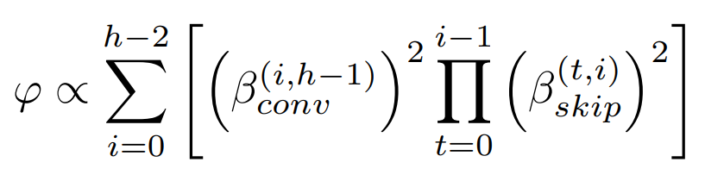
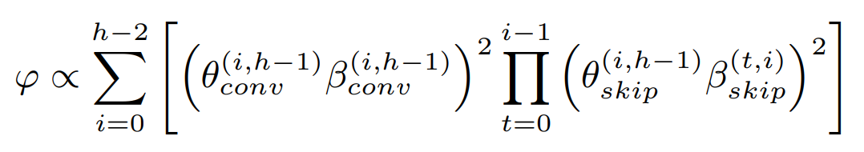
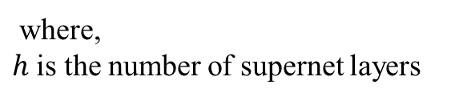
4. Benefits of Beta-Decay DARTS
Benefit 1) Probability to choose skip connection decreases
According to theorem revealed by recent work, the convergence of network weights $ω$ can heavily rely on $β_{skip}$ in the supernet.
Loss can be reduced by ratio $(1−η_{ω}φ /$ 4) with probability of at leat 1-$σ$, where $η_{ω}$ is the corresponding learning rate and will be bounded by $σ$, and $φ$ obeys.
1) Probability to choose skip connection in DARTS
where,
$h$ is the number of supernet layers
2) Probability to choose skip connection in Beta-Decay DARTS
Note that, $θ$ becomes smaller when $β$ is larger
Notes:
16

Slide 17
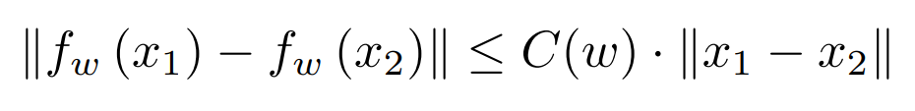
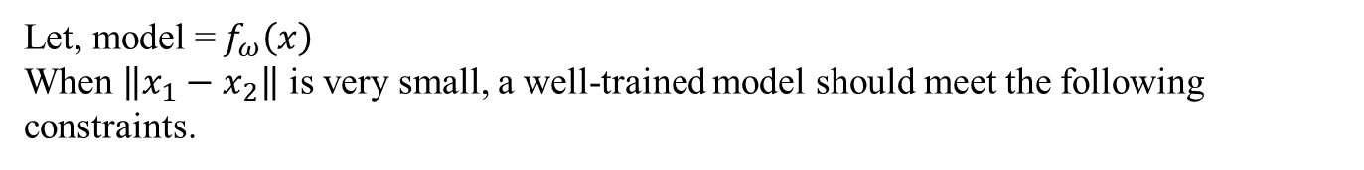
4. Benefits of Beta-Decay DARTS
Benefit 2) Stronger generalization
1. Lipschitz constraint
Let, model =$f_{ω}\left(x\right)$
When $\left\|x_{1}−x_{2}\right\|$ is very small, a well-trained model should meet the following constraints.
Where, $C(ω)$is the Lipschitz constant
The smaller the constant is, the trained model will be less sensitive to input disturbances and have better generalization ability.
Notes:
17

Slide 18
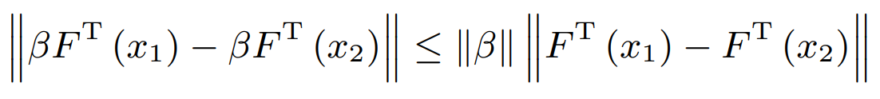
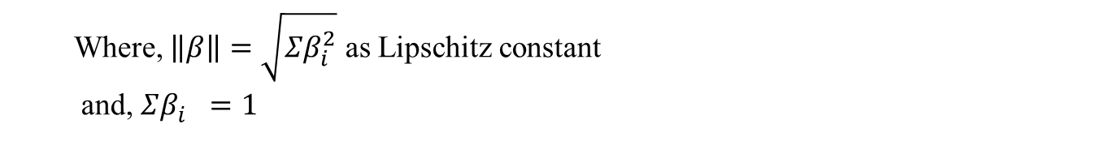
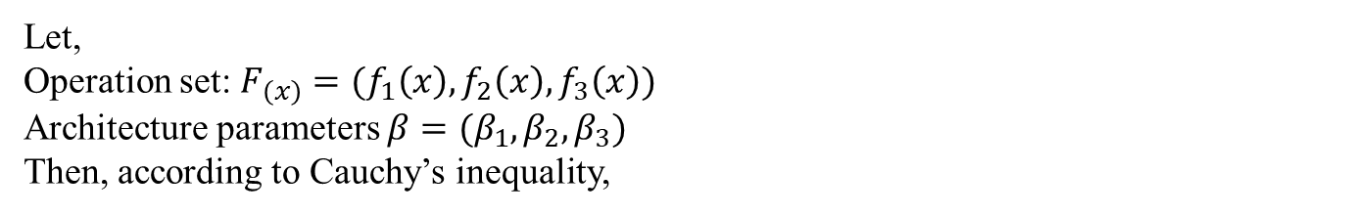
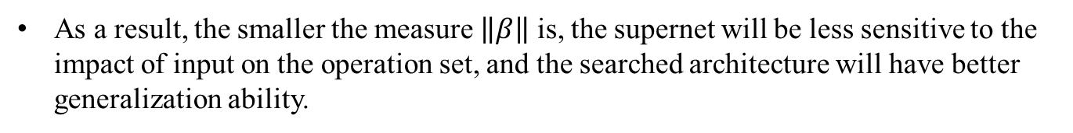
4. Benefits of Beta-Decay DARTS
Benefit 2) Stronger generalization
1. Cauchy’s inequality
Let,
Operation set: $F_{\left(x\right)}=(f_{1}\left(x\right),f_{2}\left(x\right),f_{3}\left(x\right))$
Architecture parameters $β=(β_{1},β_{2},β_{3})$
Then, according to Cauchy’s inequality,
Where, $\left\|β\right\|=\sqrt{Σβ_{i}^{2}}$ as Lipschitz constant
and, $Σβ_{i}^{}=1$
As a result, the smaller the measure $\left\|β\right\|$ is, the supernet will be less sensitive to the impact of input on the operation set, and the searched architecture will have better generalization ability.
Notes:
18

Slide 19
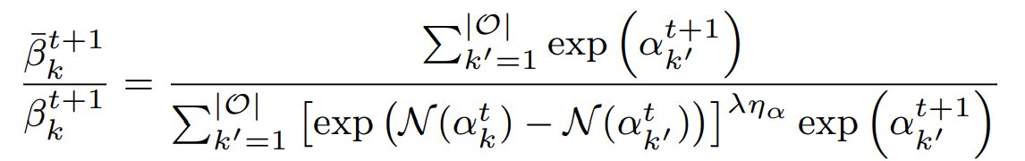
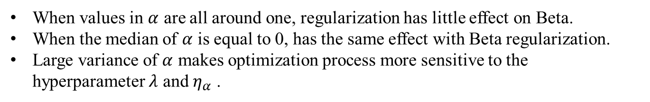
4. Benefits of Beta-Decay DARTS
Benefit 3) Comparison with commonly-used regularization
1. L2 regularization and weight decay regularization
When values in $α$ are all around one, regularization has little effect on Beta.
When the median of $α$ is equal to 0, has the same effect with Beta regularization.
Large variance of $α$ makes optimization process more sensitive to the hyperparameter $λ$ and $η_{α}$ .
Notes:
19

Slide 20
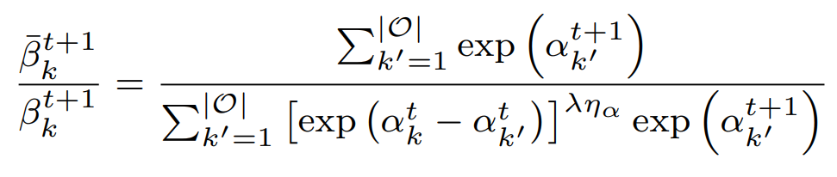
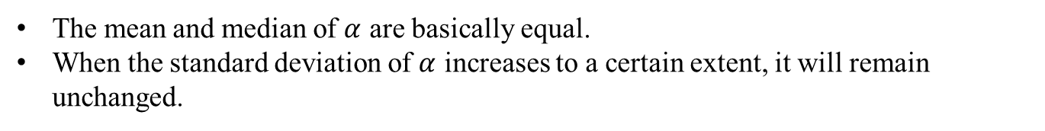
4. Benefits of Beta-Decay DARTS
Benefit 3) Comparison with commonly-used regularization
2. Beta-Decay regularization
The mean and median of $α$ are basically equal.
When the standard deviation of $α$ increases to a certain extent, it will remain unchanged.
Notes:
20

Slide 21
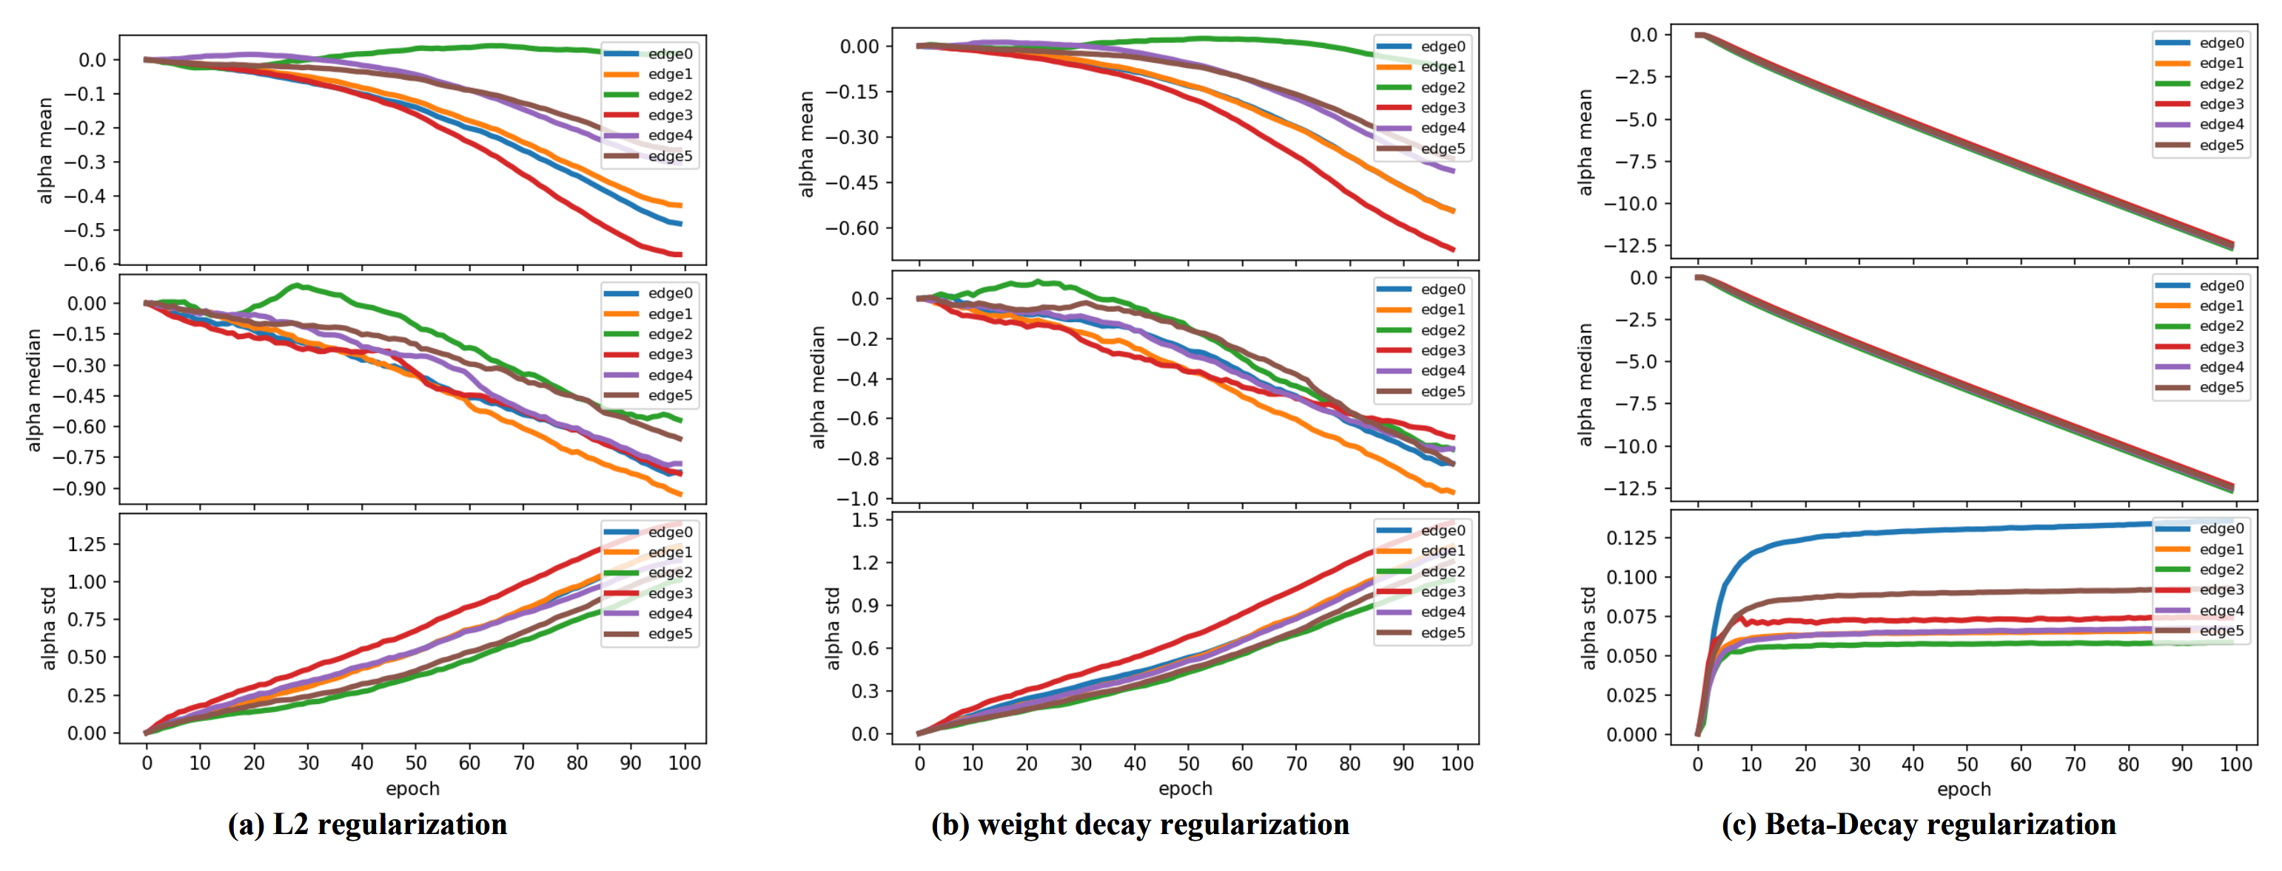
4. Benefits of Beta-Decay DARTS
Benefit 3) Comparison with commonly-used regularization
Notes:
21

Slide 22
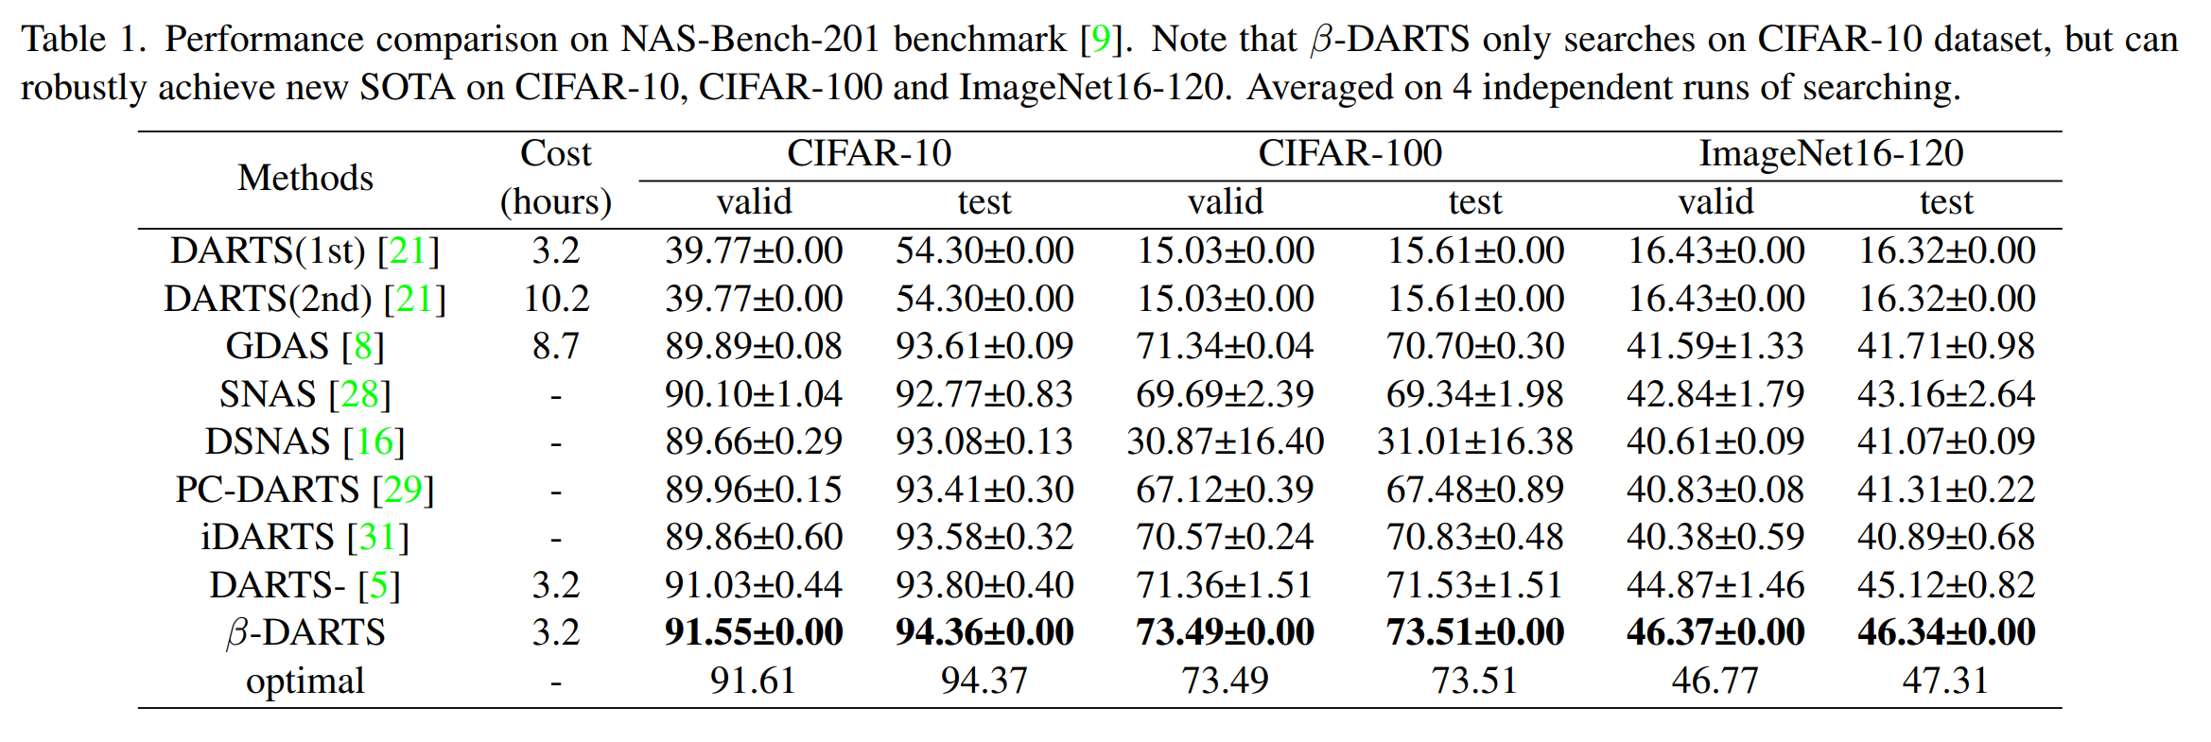
5. Experimental Results
Search on NAS-Bench-201 CIFAR-10 dataset, Adapt on NAS-Bench-201 CIFAR-10, NAS-Bench-201 CIFAR-100, NAS-Bench-201 ImageNet16-120
Notes:
22

Slide 23
5. Experimental Results
Search on NAS-Bench-201 CIFAR-10 dataset, Adapt on NAS-Bench-201 CIFAR-10, NAS-Bench-201 CIFAR-100, NAS-Bench-201 ImageNet16-120
Notes:
23

Slide 24
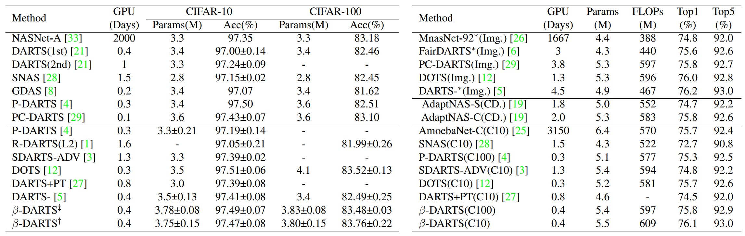
5. Experimental Results
++ : Search on CIFAR-100, test on CIFAR-10 and CIFAR-100
+ : Search on CIFAR-10, test on CIFAR-10 and CIFAR-100
Search on ImageNet / Cross Domain(CIFAR-10 and part of ImageNet) / CIFAR-10 or CIFAR-100
Notes:
24

Slide 25
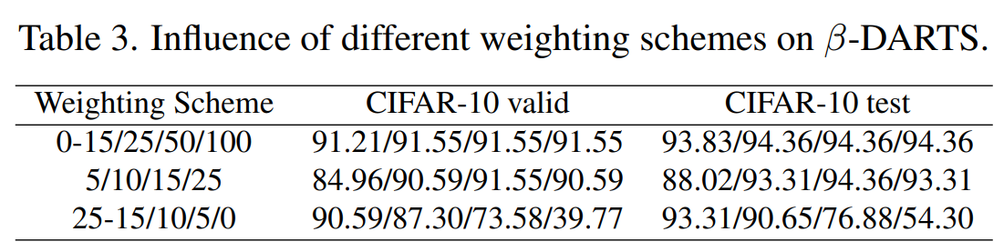
5. Experimental Results
Search on Different Weighting Scheme (Increase)
Notes:
25

Slide 26
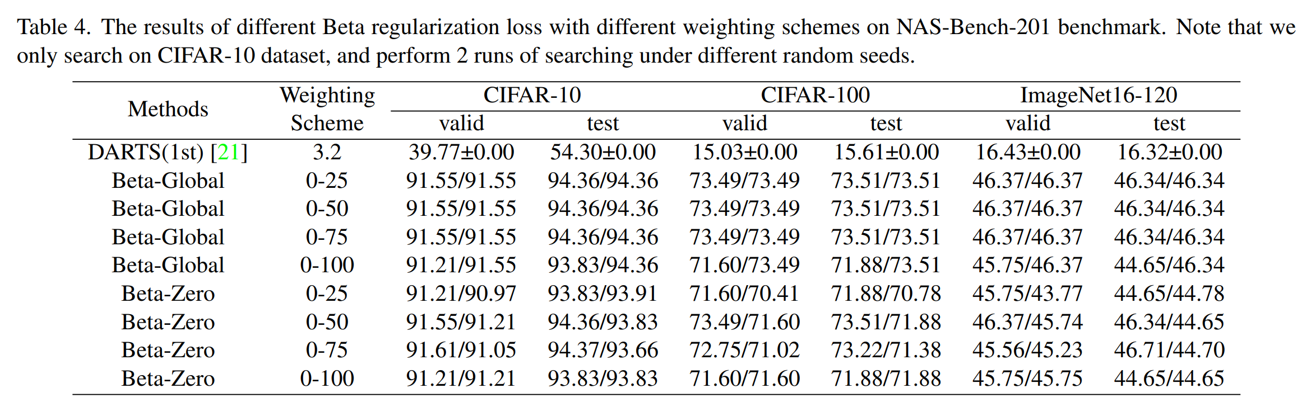
5. Experimental Results
Comparison of different weighting schemes
Notes:
26

Slide 27
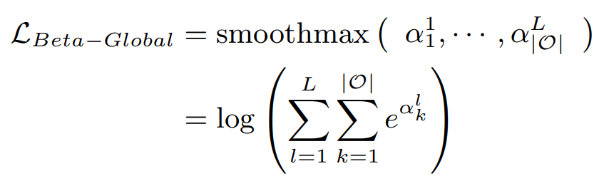
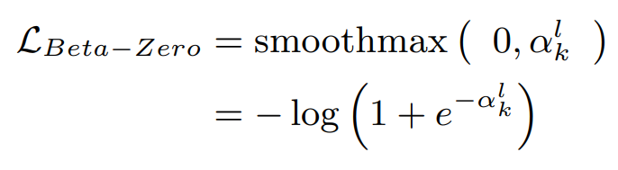
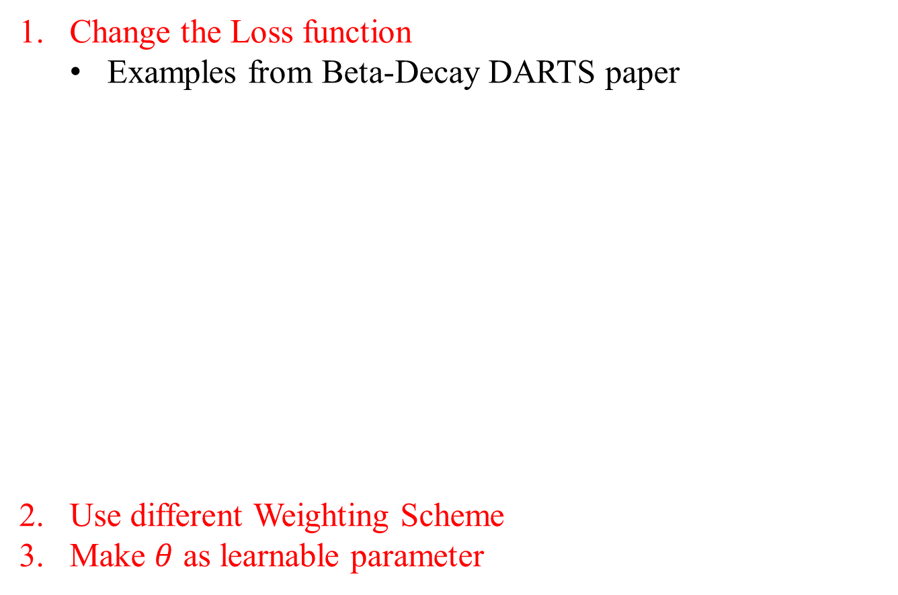
4. Conclusion
Change the Loss function
Examples from Beta-Decay DARTS paper
Use different Weighting Scheme
Make $θ$ as learnable parameter
Notes:
27

Slide 28
References
DARTS: Differentiable Architecture Search https://arxiv.org/abs/1806.09055
β-DARTS: Beta-Decay Regularization for Differentiable Architecture Search https://arxiv.org/abs/2203.01665
Theory-Inspired Path-Regularized Differential Network Architecture Search https://arxiv.org/abs/2006.16537
Notes:
28

Slide 29
Thank you
Q & A
29
Notes:
-
The training of procedure for is to maximize the probability of D making a mistake. This framework corresponds to a minimax two-player game.
In the space of arbitrary functions G and D, a unique solution exists, with G recovering the training data distribution and D equal to ½ everywhere.
29

